Slide 1
KNN(K-Nearest Neighbour)
Kishan G

Slide 2
KNN Algorithm - Lazy Learner
When the KNN algorithm gets the training data, it does not learn and make a model, it just stores the data. Instead of finding any discriminative function with the help of the training data, it follows instance-based learning and also uses the training data when it actually needs to do some prediction on the unseen datasets.
As a result, KNN does not immediately learn a model rather delays the learning thereby being referred to as Lazy Learner

Slide 3
KNN Algorithm
KNN(K-nearest neighbours) is a supervised learning and non-parametric algorithm that can be used to solve both classification and regression problem statements.
It uses data in which there is a target column present i.e, labelled data to model a function to produce an output for the unseen data. It uses the euclidean distance formula to compute the distance between the data points for classification or prediction.
The main objective of this algorithm is that similar data points must be close to each other so it uses the distance to calculate the similar points that are close to each other.

Slide 4
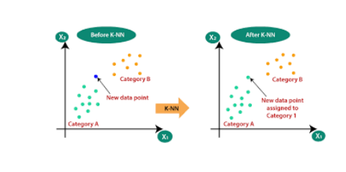
KNN Algorithm
The main objective of this algorithm is that similar data points must be close to each other so it uses the distance to calculate the similar points that are close to each other.

Slide 5
Regression kNN model vs Classification kNN model
The key differences are:
KNN regression tries to predict the value of the output variable by using a local average.
KNN classification attempts to predict the class to which the output variable belong by computing the local probability.

Slide 6
KNN a non-parametric Algorithm
The term “non-parametric” refers to not making any assumptions on the underlying data distribution. These methods do not have any fixed numbers of parameters in the model.
Similarly in KNN, the model parameters grow with the training data by considering each training case as a parameter of the model. So, KNN is a non-parametric algorithm..

Slide 7
What is “K” in the KNN Algorithm
K represents the number of nearest neighbours you want to select to predict the class of a given item, which is coming as an unseen dataset for the model.

Slide 8
KNN algorithm - predictions on the unseen dataset
The following operations have happened during each iteration of the algorithm. For each of the unseen or test data point, the kNN classifier must:
Step-1: Calculate the distances of test point to all points in the training set and store them.
Step-2: Sort the calculated distances in increasing order.
Step-3: Store the K nearest points from our training dataset.
Step-4: Calculate the proportions of each class.
Step-5: Assign the class with the highest proportion

Slide 9
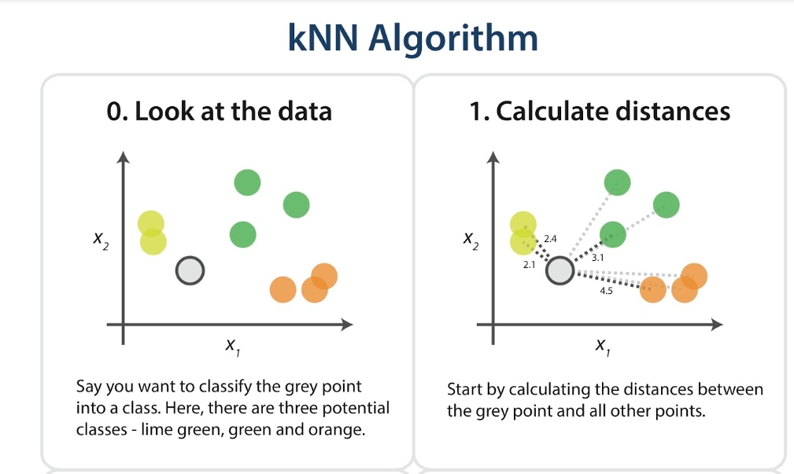
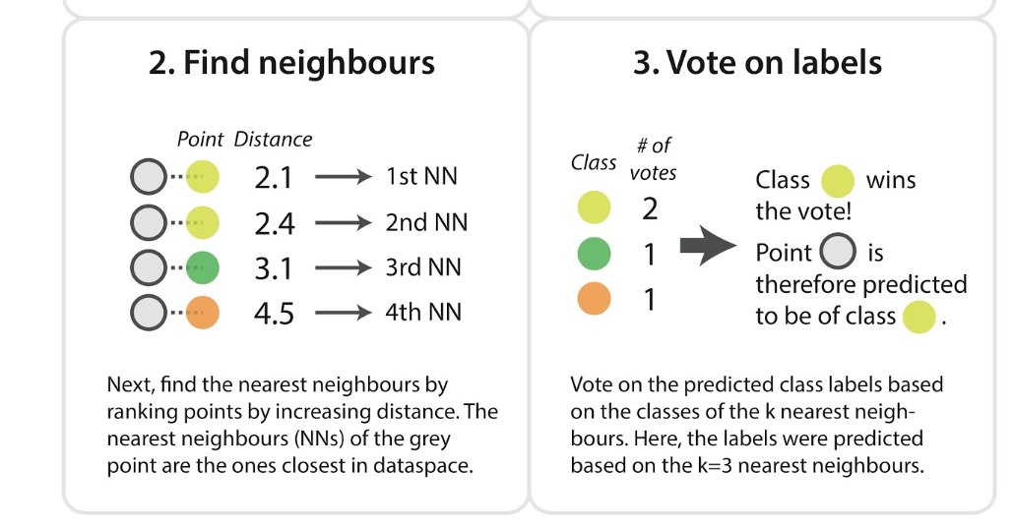

Slide 10
Why is the odd value of “K” preferred over even values in the KNN Algorithm?
The odd value of K should be preferred over even values in order to ensure that there are no ties in the voting. If the square root of a number of data points is even, then add or subtract 1 to it to make it odd.

Slide 11
Can KNN be used for value imputation in both categorical and continuous categories of data
KNN is the only algorithm that can be used for the imputation of both categorical and continuous variables. It can be used as one of many techniques when it comes to handling missing values.
To impute a new sample, we determine the samples in the training set “nearest” to the new sample and averages the nearby points to impute. A Scikit learn library of Python provides a quick and convenient way to use this technique.
”

Slide 12
Space and Time complexity of the KNN Algorithm
Time complexity:
The distance calculation step requires quadratic time complexity, and the sorting of the calculated distances requires an O(N log N) time. Together, we can say that the process is an O(N 3 log N) process, which is a monstrously long process.
Space complexity:
Since it stores all the pairwise distances and is sorted in memory on a machine, memory is also the problem. Usually, local machines will crash, if we have very large datasets.

Slide 13
Can KNN Algorithm used large datasets
No,it is not recommended to use
The Problem in processing the data:
KNN works well with smaller datasets because it is a lazy learner. It needs to store all the data and then make a decision only at run time. It includes the computation of distances for a given point with all other points. So if the dataset is large, there will be a lot of processing which may adversely impact the performance of the algorithm.
Sensitive to noise:
Another thing in the context of large datasets is that there is more likely a chance of noise in the dataset which adversely affects the performance of the KNN algorithm since the KNN algorithm is sensitive to the noise present in the dataset.

Slide 14
How to choose the optimal value of K in the KNN Algorithm
There is no straightforward method to find the optimal value of K in the KNN algorithm.
You have to play around with different values to choose which value of K should be optimal for my problem statement. Choosing the right value of K is done through a process known as Hyperparameter Tuning.
The optimum value of K for KNN is highly dependent on the data itself. In different scenarios, the optimum K may vary. It is more or less a hit and trial method.

Slide 15
Optimal value of K
There is no one proper method of finding the K value in the KNN algorithm. No method is the rule of thumb but you should try the following suggestions:
1. Square Root Method:
Take the square root of the number of samples in the training dataset and assign it to the K value.
2. Cross-Validation Method:
We should also take the help of cross-validation to find out the optimal value of K in KNN. Start with the minimum value of k i.e, K=1, and run cross-validation, measure the accuracy, and keep repeating till the results become consistent.
As the value of K increases, the error usually goes down after each one-step increase in K, then stabilizes, and then raises again. Finally, pick the optimum K at the beginning of the stable zone. This technique is also known as the Elbow Method.

Slide 16
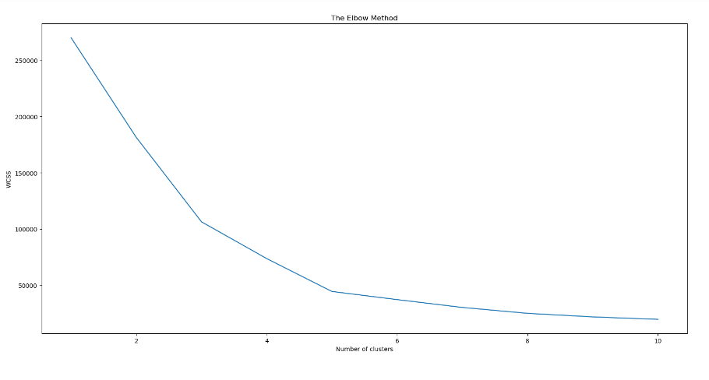
3. Domain Knowledge:
Sometimes with the help of domain knowledge for a particular use case we are able to find the optimum value of K (K should be an odd number).

Slide 17
How to handle categorical variables in the KNN Algorithm
To handle the categorical variables we have to create dummy variables out of a categorical variable and include them instead of the original categorical variable. Unlike regression, create k dummies instead of (k-1).
For example, a categorical variable named “Degree” has 5 unique levels or categories. So we will create 5 dummy variables. Each dummy variable has 1 against its degree and else 0.

Slide 18
KNN Algorithm relate to the Bias-Variance tradeoff
Problem with having too small K:
The major concern associated with small values of K lies behind the fact that the smaller value causes noise to have a higher influence on the result which will also lead to a large variance in the predictions.
Problem with having too large K:
The larger the value of K, the higher is the accuracy. If K is too large, then our model is under-fitted. As a result, the error will go up again. So, to prevent your model from under-fitting it should retain the generalization capabilities otherwise there are fair chances that your model may perform well in the training data but drastically fail in the real data. The computational expense of the algorithm also increases if we choose the k very large.
So, choosing k to a large value may lead to a model with a large bias(error).

Slide 19
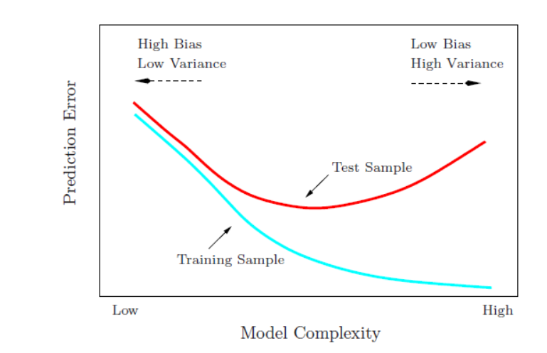
KNN Algorithm relate to the Bias-Variance tradeoff
The effects of k values on the bias and variance is explained below :
As the value of k increases, the bias will be increases
As the value of k decreases, the variance will increases
With the increasing value of K, the boundary becomes smoother
So, there is a tradeoff between overfitting and underfitting and you have to maintain a balance while choosing the value of K in KNN. Therefore, K should not be too small or too large.

Slide 20
The KNN algorithm does more computation on test time rather than train time
The basic idea behind the kNN algorithm is to determine a k-long list of samples that are close to a sample that we want to classify. Therefore, the training phase is basically storing a training set, whereas during the prediction stage the algorithm looks for k-neighbours using that stored data. Moreover, KNN does not learn anything from the training dataset as well.

Slide 21
What are the things which should be kept in our mind while choosing the value of k in the KNN Algorithm
If K is small, then results might not be reliable because the noise will have a higher influence on the result. If K is large, then there will be a lot of processing to be done which may adversely impact the performance of the algorithm.
So, the following things must be considered while choosing the value of K:
K should be the square root of n (number of data points in the training dataset).
K should be chosen as the odd so that there are no ties. If the square root is even, then add or subtract 1 to it.

Slide 22
Step-by-Step explanation of the mathematical process behind K-NN:
Define a distance metric:
The first step in K-NN is to choose a distance metric. The most commonly used distance metrics are Euclidean distance and Manhattan distance. The choice of distance metric depends on the nature of the data.
Calculate the distance between the new sample and all training examples:
The next step is to calculate the distance between the new sample and all the training examples using the chosen distance metric.
Select the k nearest neighbors:
After calculating the distances, we sort the distances in ascending order and select the k training examples that are closest to the new sample.
Predict the class:
The final step is to predict the class of the new sample based on the majority class among the k nearest neighbors. In case of a tie, the class can be decided randomly or based on some other criterion.

Slide 23
KNN – Distance metrices
Euclidean distance:
This is the most commonly used distance metric in KNN. It is based on the Pythagorean theorem and calculates the straight-line distance between two points in a multi-dimensional space.
Manhattan distance:
Also known as the "taxi-cab" distance, this metric calculates the sum of the absolute differences between the coordinates of two points in a multi-dimensional space. It is best used when the data points have different scales.
Minkowski distance:
This is a generalization of both Euclidean and Manhattan distances and is a combination of the two. The user can specify a parameter p that determines whether the distance is calculated as Euclidean or Manhattan.
Cosine similarity:
This distance metric is used when the data is in the form of vectors and calculates the cosine of the angle between two vectors. It is commonly used in text classification and recommendation systems.

Slide 24
Euclidean distance
Euclidean Distance:
The Euclidean distance between two points in a multi-dimensional space is calculated as the straight line distance between the two points. It is defined as the square root of the sum of the squared differences of the coordinates. Mathematically, the Euclidean distance between two points (x1, y1) and (x2, y2) can be expressed as:
d = √((x2 - x1)^2 + (y2 - y1)^2)
For example, consider two points A(2, 3) and B(4, 5). The Euclidean distance between them can be calculated as:
d = √((4 - 2)^2 + (5 - 3)^2) = √(4 + 4) = 2√2
Real-life example:
Euclidean distance can be used in various fields, for instance, in image processing to measure the similarity between two images. Another example could be in a recommendation system, where Euclidean distance can be used to calculate the distance between users and items to recommend items that are closest to a particular user.

Slide 25
Manhattan Distance
The Manhattan distance:
also known as "taxi-cab" distance, is calculated as the sum of the absolute differences of the coordinates. It assumes that you can only move along the axes and not diagonally. Mathematically, the Manhattan distance between two points (x1, y1) and (x2, y2) can be expressed as:
d = |x2 - x1| + |y2 - y1|
For example, consider two points A(2, 3) and B(4, 5). The Manhattan distance between them can be calculated as:
d = |4 - 2| + |5 - 3| = 2 + 2 = 4
Real-life example:
Manhattan distance can be used in various fields such as robotics, where it can be used to measure the distance between two positions on a grid-based map. Another example could be in natural language processing, where Manhattan distance can be used to measure the similarity between words based on the number of character changes required to convert one word into another.

Slide 26
Advantages of the KNN Algorithm
Some of the advantages of the KNN algorithm are as follows:
No Training Period:
It does not learn anything during the training period since it does not find any discriminative function with the help of the training data. In simple words, actually, there is no training period for the KNN algorithm. It stores the training dataset and learns from it only when we use the algorithm for making the real-time predictions on the test dataset.
As a result, the KNN algorithm is much faster than other algorithms which require training. For Example, SupportVector Machines(SVMs), Linear Regression, etc. Moreover, since the KNN algorithm does not require any training before making predictions as a result new data can be added seamlessly without impacting the accuracy of the algorithm.
Easy to implement and understand:
To implement the KNN algorithm, we need only two parameters i.e. the value of K and the distance metric(e.g. Euclidean or Manhattan, etc.). Since both the parameters are easily interpretable therefore they are easy to understand.

Slide 27
Disadvantages of the KNN Algorithm
Some of the disadvantages of the KNN algorithm are as follows:
1. Does not work well with large datasets:
In large datasets, the cost of calculating the distance between the new point and each existing point is huge which decreases the performance of the algorithm.
2. Does not work well with high dimensions:
KNN algorithms generally do not work well with high dimensional data since, with the increasing number of dimensions, it becomes difficult to calculate the distance for each dimension.
3. Need feature scaling:
We need to do feature scaling (standardization and normalization) on the dataset before feeding it to the KNN algorithm otherwise it may generate wrong predictions.
4. Sensitive to Noise and Outliers:
KNN is highly sensitive to the noise present in the dataset and requires manual imputation of the missing values along with outliers removal.

Slide 28
Real-life applications of KNN Algorithms
KNN allows the calculation of the credit rating.
By collecting the financial characteristics vs. comparing people having similar financial features to a database we can calculate the same. Moreover, the very nature of a credit rating where people who have similar financial details would be given similar credit ratings also plays an important role. Hence the existing database can then be used to predict a new customer’s credit rating, without having to perform all the calculations.
2. In political science:
KNN can also be used to predict whether a potential voter “will vote” or “will not vote”, or to “vote Democrat” or “vote Republican” in an election. Apart from the above-mentioned use cases, KNN algorithms are also used for handwriting detection (like OCR), Image recognition, and video recognition.

Slide 29
Conclusion
In conclusion, K-Nearest Neighbors (KNN) is a simple and effective machine learning algorithm that is used for both classification and regression problems. It is based on the idea of finding the closest k training data points to a new data point and assigning the majority class among these nearest neighbors as the prediction for the new data point.
The choice of k and the distance metric is critical in KNN, as they determine the smoothness of the decision boundary and the accuracy of the predictions. A larger value of k results in a smoother decision boundary, while a smaller value of k results in a more complex decision boundary. The choice of distance metric depends on the problem and the nature of the data.
KNN is a versatile and easy-to-implement algorithm that can be used for a variety of problems, but it can be computationally expensive for large datasets. However, it is especially useful for problems with small datasets where complex models might overfit.
Overall, KNN is a powerful tool in the machine learning toolkit, and its simplicity and versatility make it a popular choice for many problems in the field.

